Slide 1
Search & Rescue During Structural Fire
Presented by
Md. Ruhul Amin
Warehouse Inspector
Office of Assistant Director, Dhaka

Slide 2
Contents
Elementary Equipment Needed for Search and Rescue
FBI – Fire Behavior Indicators
Smoke Reading
Sar Concept/Strategies/Tactic

Slide 3
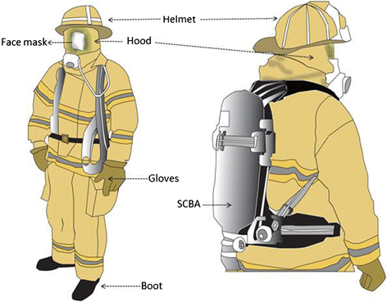
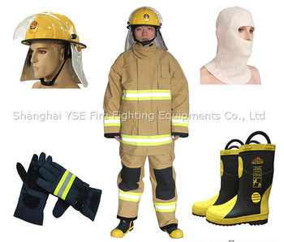
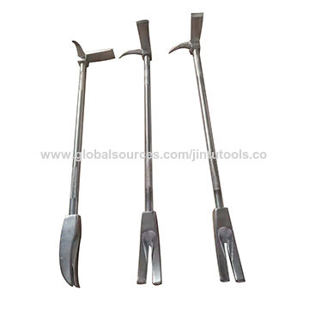
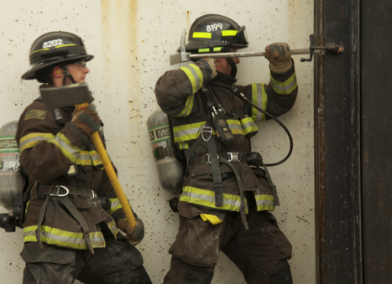
Elementary Equipment Needed for
Search and Rescue
Full personal protective clothing
Self contained breathing apparatus
Radio, forcible entry tool, flashlight
A Partner
Hose line or a safety rope to entry/exit door

Slide 4
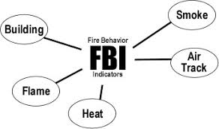
FBI – FIRE BEHAVIOR INDICATORS
To avoid unwanted fatalities, injuries of firefighters due to rapid fire progress during SAR in structural fire.
Be aware of structural vulnerability
BSHAF

Slide 5
B – BUILDING
Structural, Nonstructural, Partition wall (load bearing/non load bearing) Fire resistive/non fire resistive
Residential/Industrial/Commercial/ Mix occupancy/Educational/ Health facilities Stored combustible materials
Interior/Exterior Finishing Materials Ventialtion Factor (Design/Natural/Mechanical)
Building construction influences both fire development and potential for collapse.
Occupancy and related contents will have a major impact fire dynamics. (Consider fire behavior during pre-incident planning.)
Elements to consider: Construction, Contents, Size, Ventilation Profile & Fire Protection Systems.

Slide 6
B – BUILDING
Structural, Nonstructural, Partition wall (load bearing/non load bearing) Fire resistive/non fire resistive
Residential/Industrial/Commercial/ Mix occupancy/Educational/ Health facilities Stored combustible materials
Interior/Exterior Finishing Materials Ventialtion Factor (Design/Natural/Mechanical)
Building construction influences both fire development and potential for collapse.
Occupancy and related contents will have a major impact fire dynamics. (Consider fire behavior during pre-incident planning.)
Elements to consider: Construction, Contents, Size, Ventilation Profile & Fire Protection Systems.

Slide 7
B – BUILDING
Structural, Nonstructural, Partition wall (load bearing/non load bearing) Fire resistive/non fire resistive
Residential/Industrial/Commercial/ Mix occupancy/Educational/ Health facilities Stored combustible materials
Interior/Exterior Finishing Materials Ventialtion Factor (Design/Natural/Mechanical)
Building construction influences both fire development and potential for collapse.
Occupancy and related contents will have a major impact fire dynamics. (Consider fire behavior during pre-incident planning.)
Elements to consider: Construction, Contents, Size, Ventilation Profile & Fire Protection Systems.

Slide 8
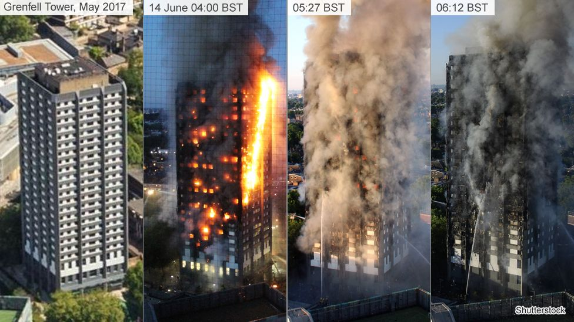

Slide 9
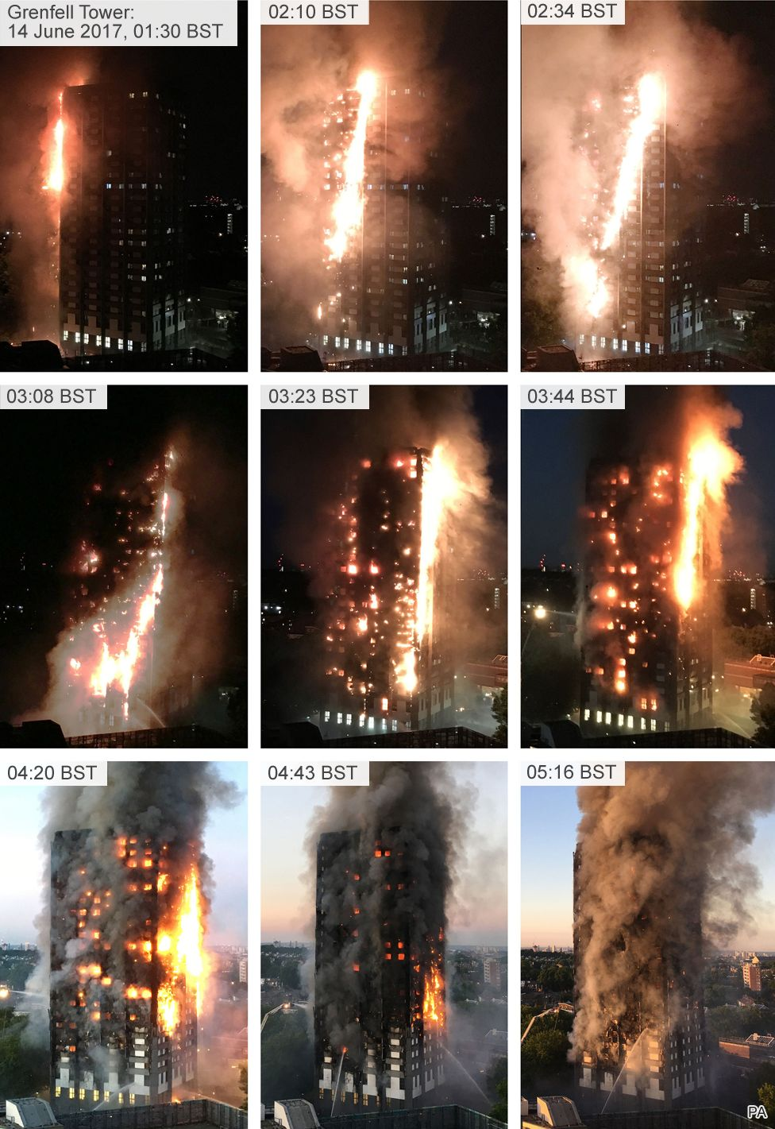
Fire Growth & impact on Structure & construction material

Slide 10
Fire Growth & impact on Structure & construction material

Slide 11
Fire Growth & impact on Structure & construction material

Slide 12
Fire Growth & impact on Structure & construction material

Slide 13
Fire Growth & impact on Structure & construction material

Slide 14
Fire Growth & impact on Structure & construction material

Slide 15
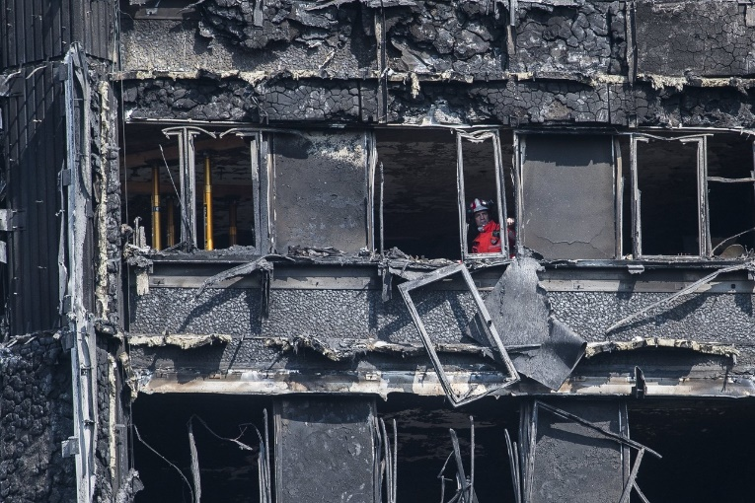
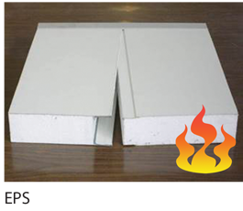
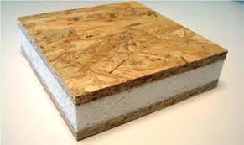
Fire Growth & impact on Structure & construction material

Slide 16
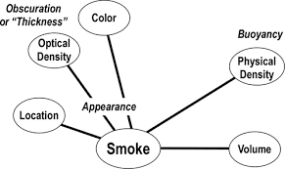
S – SMOKE
Extremely useful in determining fire location and extent.
Smoke indicators may be visible on the exterior as well as inside the building.
Reading the smoke is critical, but not sufficient in predicting fire behavior.
Elements to consider: Location, Optical Density (Thickness), Color, Physical Density (Buoyancy), Volume.

Slide 17
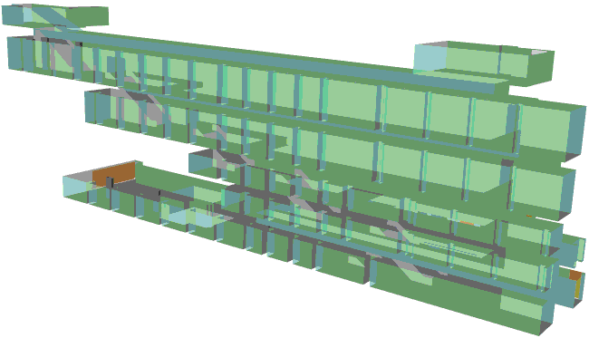
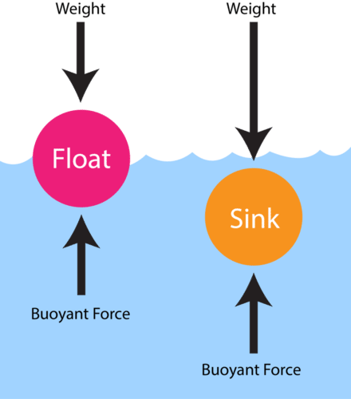
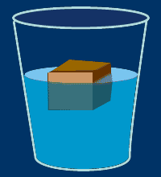
Buoyancy Induced Smoke Movement
https://www.youtube.com/watch?v=cLBtRwJ93aQ

Slide 18
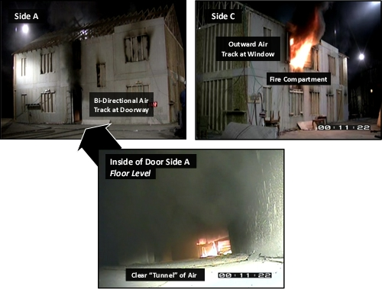
A – AIR TRACK
Air track includes movement of both smoke and air.
Observation of air track:
  Starts from the exterior
  Becomes more critical when making entry.
  Continues to be important while working inside.
Elements to consider:
  Direction, Wind, Velocity & Flow

Slide 19
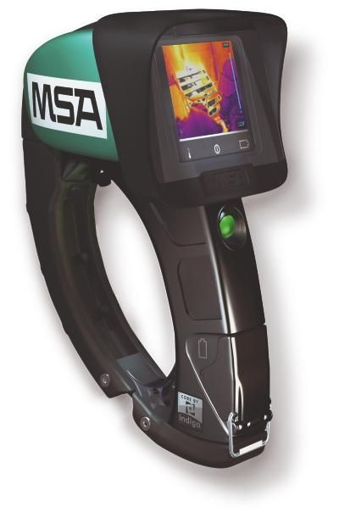
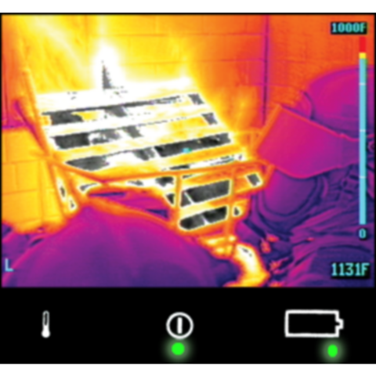
H – HEAT
Heat and temperature cannot be directly observed:
  Indirect indicators
  Tactile indicators
Protective clothing provides insulation,
Temperature changes faster than we feel it!

Slide 20
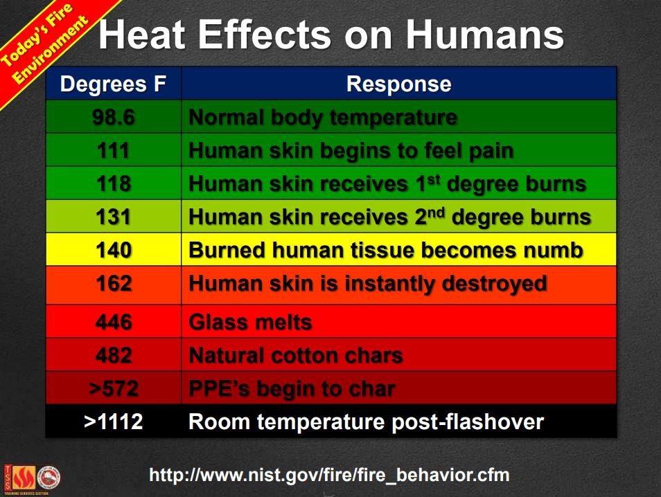
H – HEAT

Slide 21
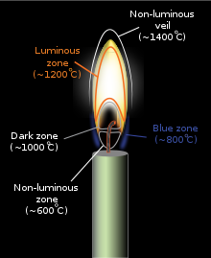
F – FLAME
Flames may be obvious, but these indicators must be integrated with the other B-SAHF indicators.
Elements to consider: Location, Size, Color, Duration, Auto-ignition

Slide 22
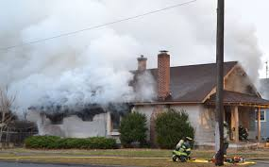
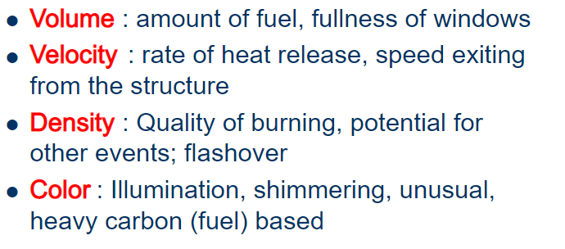
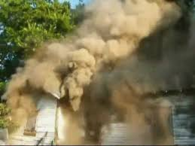
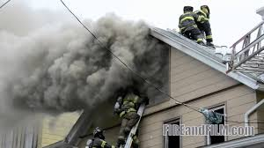
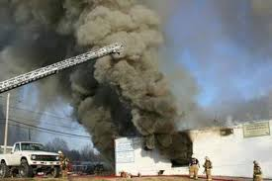
Smoke Reading
Determining the four key attributes of smoke
Notes:
Shimmering ঝলমলে

Slide 23
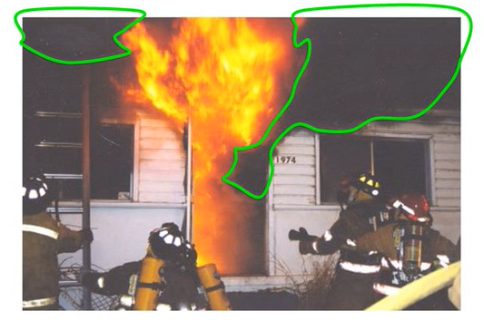
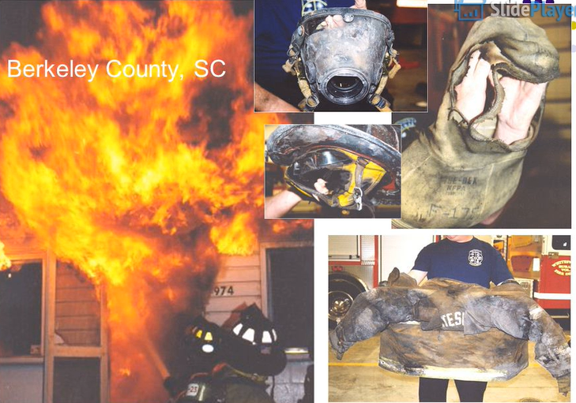
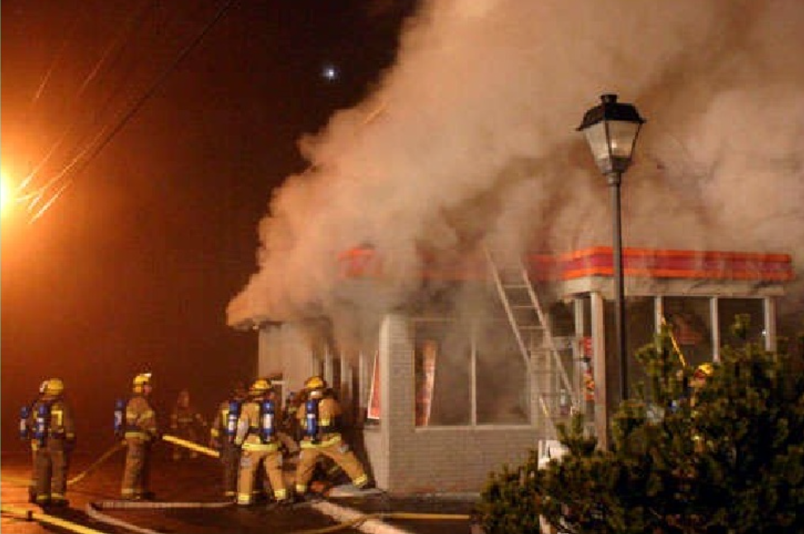
Smoke Reading
In what ways are they changing?
How rapidly are these changes occurring?
What do these changes suggest about the progression of the fire?
Two triggers: right temperature, right mixture

Slide 24
SAR concept/Strategies/Tactic
-Remove endangered occupants
-Control The Fire
-Rmove Smoke & Toxic Gases
-Rescue
-Confine/Extingusih
-Natural/Tactical Ventilation
-Conduct Primary Search
-Place hose lines inside to control the fire
-Ventilate the building horizontally/vertically
Objectives | Strategies | Tactics

Slide 25
SAR concept/Strategies/Tactic
-Remove endangered occupants
-Control The Fire
-Rmove Smoke & Toxic Gases
-Rescue
-Confine/Extingusih
-Natural/Tactical Ventilation
-Conduct Primary Search
-Place hose lines inside to control the fire
-Ventilate the building horizontally/vertically
Objectives | Strategies | Tactics

Slide 26
SAR concept/Strategies/Tactic
-Remove endangered occupants
-Control The Fire
-Rmove Smoke & Toxic Gases
-Rescue
-Confine/Extingusih
-Natural/Tactical Ventilation
-Conduct Primary Search
-Place hose lines inside to control the fire
-Ventilate the building horizontally/vertically
Objectives | Strategies | Tactics

Slide 27
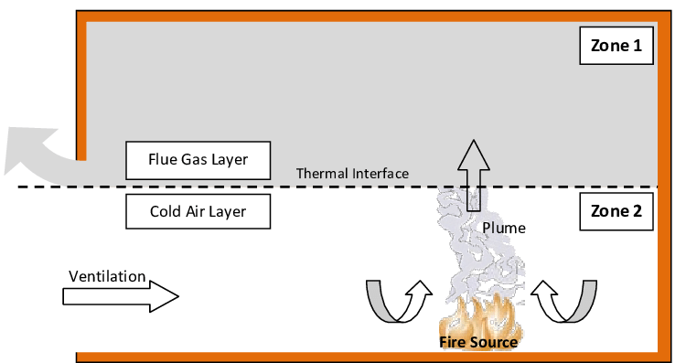
SAR in Structure
Phase of Search & Rescue:
Primary Search
  • Early action
  • Fast movement
  • Victims can be seen
  • No other activities

Slide 28
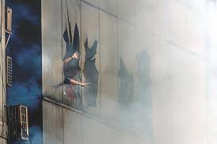
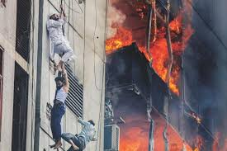
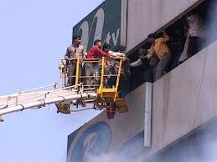
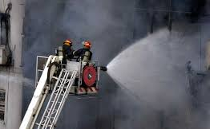
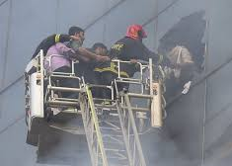
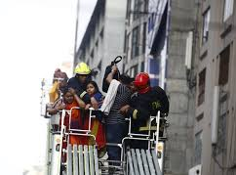
Priority of Rescue

Slide 29
SAR in Structure
ii. Secondary Search
  • Fast movement
  • Search victims (can’t see victims)
  • Victims hide/trap
  • Use equipments (SCBA, hose, mechanical ventilation etc.)

Slide 30
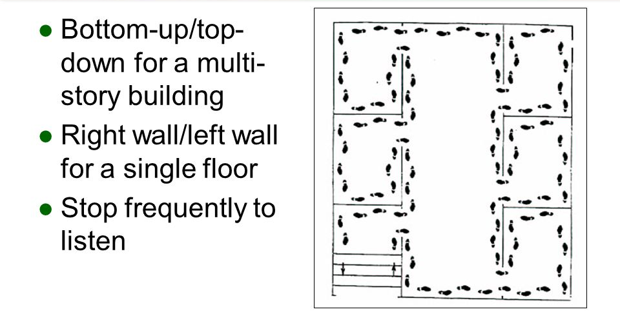
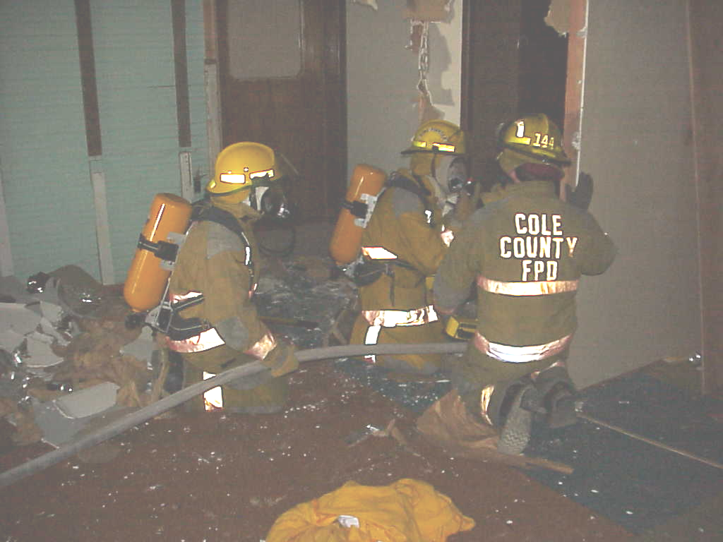
Entry into a structure
Get down low, check door for heat, open door and check flooring
Enter Structure and perform either a right or a left and search
At least once a room Yell (Fire Department is anyone in here)
Always STAY TOGETHER

Slide 31
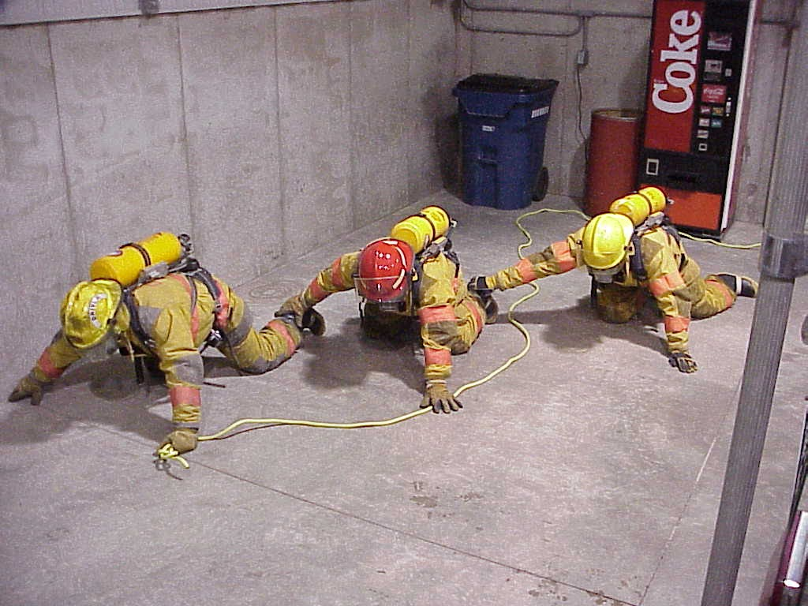
As Entering
First person deciminate through radios that team is entering and give the name of the team and the direction of search to the commander.
Second person is to grab the outer boot of first rescuer and search with a tool in the other hand as far as he can reach.
Third Person is to do the same as second rescuer except to hold onto the second mans outer boot

Slide 32
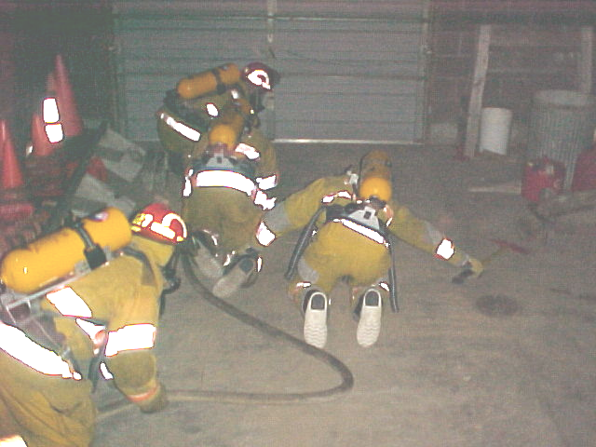
During Search
Always keep the team informed of what you are finding. (windows, doors, closets)
Always be aware of your partner(s)
Feel the walls for windows or secondary egress routes.
Search all areas (Toilets, under beds/tables Etc.)
Ventilate when possible taking care not to give the fire air

Slide 33
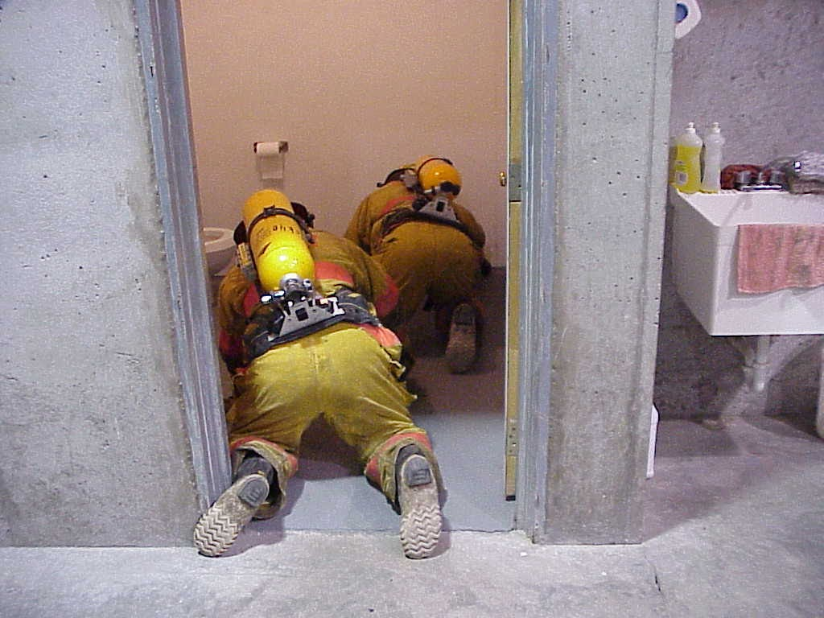
Small area search technique
First person enters while second holds doorway.
Then second enters while third holds doorway.
Speeds up the process of the search.

Slide 34
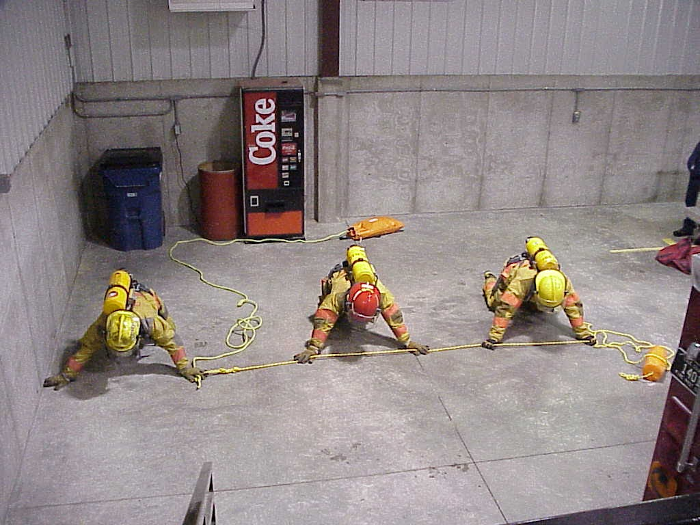
Large area search Technique
In larger rooms you can use webbing or a short rope to keep contact with your team.
You could hold hands.
Using these during a search can extend your search area further into a room to get a full and accurate sweep.

Slide 35
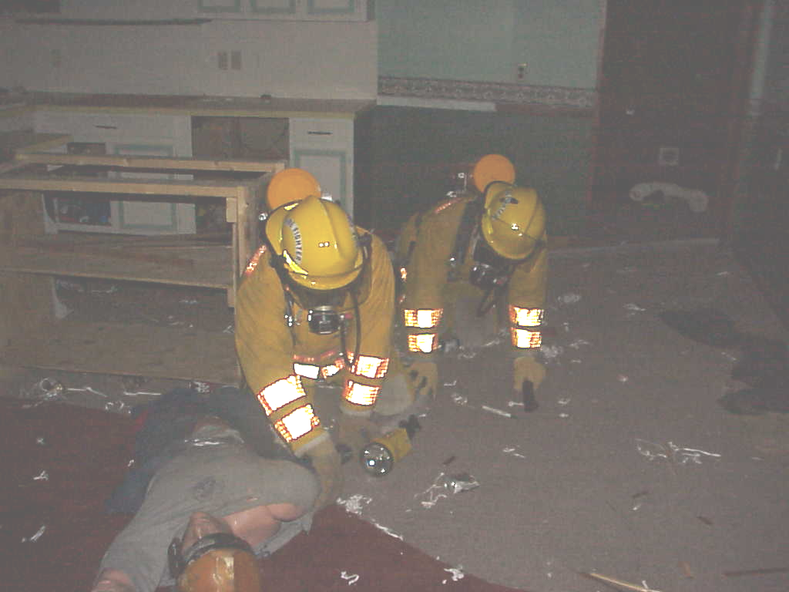
Finding Victim
Radio command of whereabouts of the victim and status of the victim to get EMS teams ready.
Leave a tool or something to mark your end of search so the next team can take over.
During exit time, explain to next team all about your search so they have your information to make their search

Slide 36
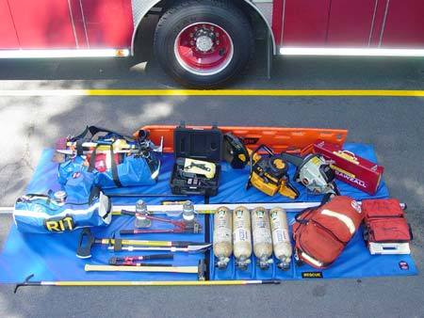
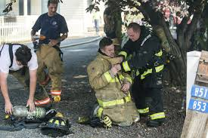
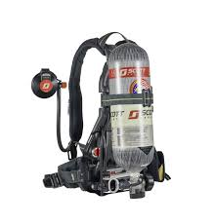
After exiting the Building
Always put your tools in a proper staging area, or put it back in its place in service.
Extend your air pack straps, check it over, clean it, fill the air tank, put in back in a staging area or in its place on the truck.
Go to rehab

Slide 37
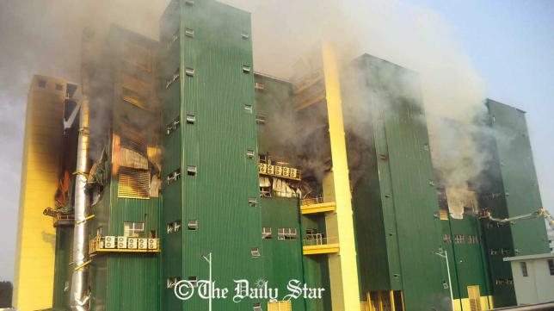
Structural collapse all call
Whenever anyone finds a structural problem alert the commander of it.
If the commander sees bad sign he will call all personnel out of the building by the use of his radio and the use of an air horn/ whistle on a truck.
It consists of three blasts of the air horns three times as well as a radio message to immediately egress out of the building.

Slide 38
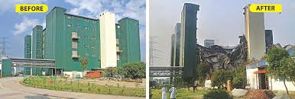
Structural collapse all call
https://www.youtube.com/watch?v=bN2O_k7QJlY

Slide 39
Things to be remembered
Do the best job you can with the resources you have.
Search thoroughly
Take care of you and your team FIRST.
Stay low and together
Always use a hose line or a rope to the exit when you search.
Always take care of yourself and your partners.
We are called to be a solution to, not to add to the problem.
YOU are the most important person on any scene!
Remember: practice does not make perfect. PERFECT PRACTICE MAKES PERFECT!!!

Slide 40


Slide 41


Slide 42
Potential energy convert to Kinetic energy and light
https://www.youtube.com/watch?v=eocyl9dZ7W0

