Slide 1
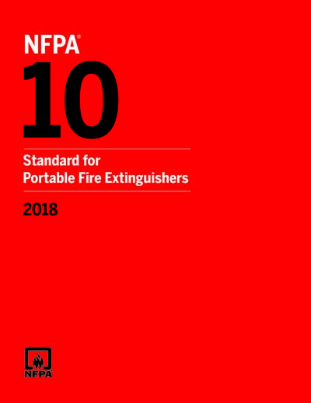
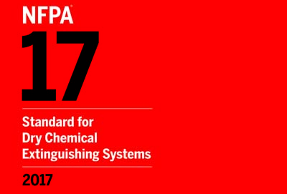
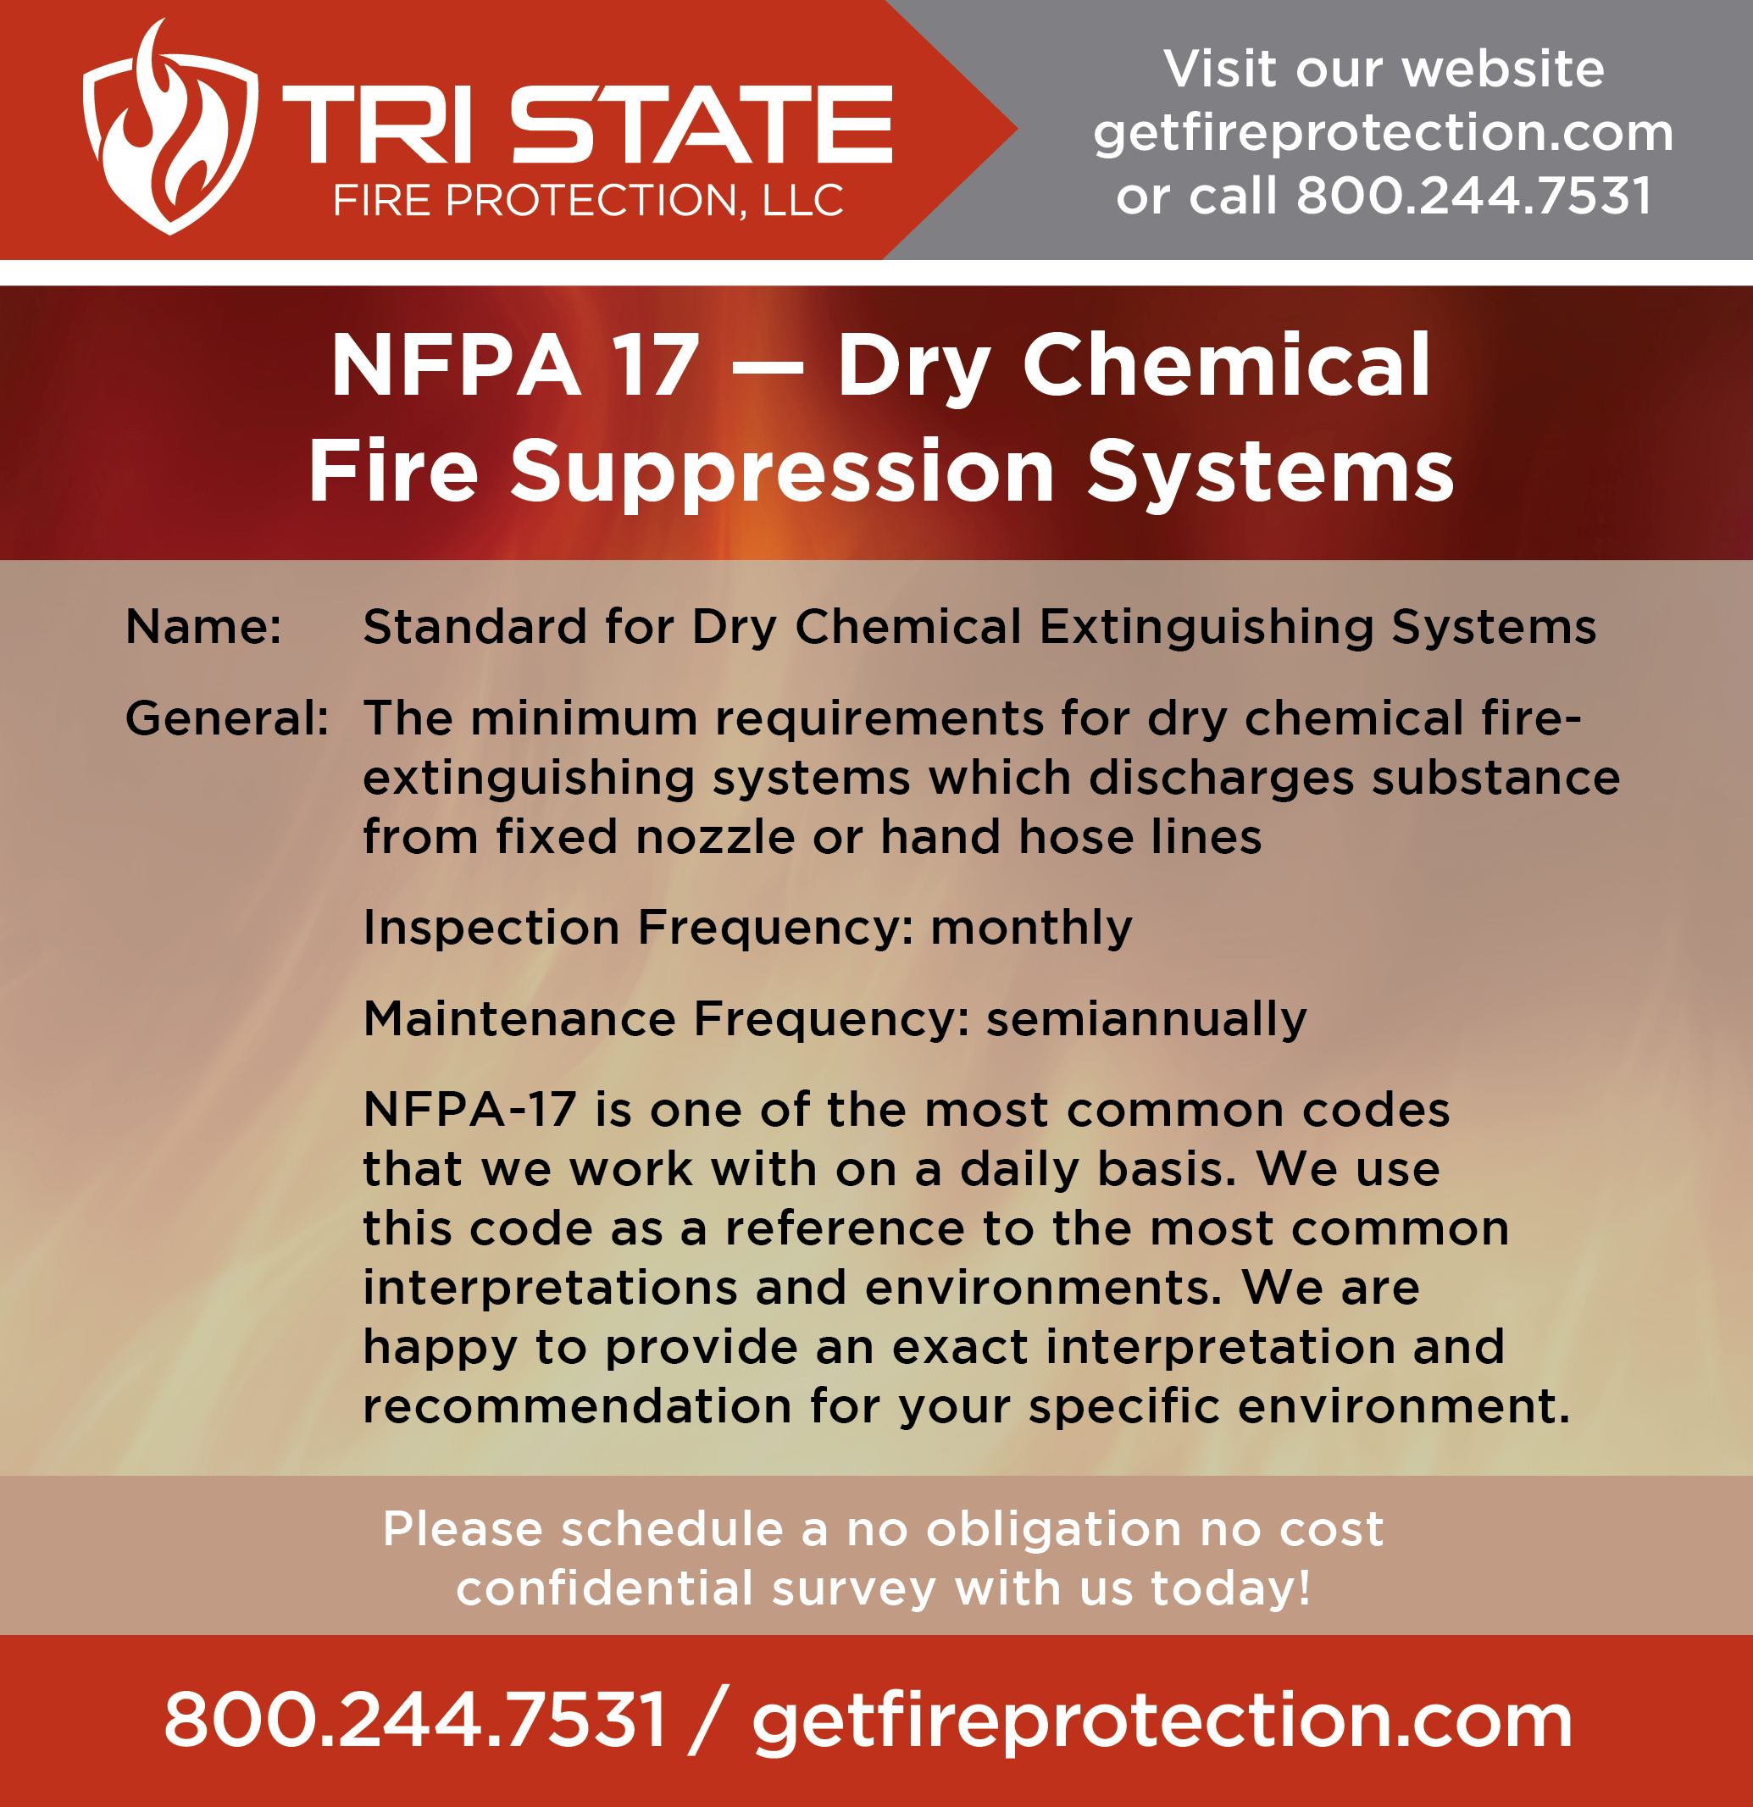
2021 Edition
Presented By
Md Ruhul Amin
Warehouse Inspector

Slide 2
Contents
Introductory
Chapter 4: Components
Chapter 5: System Requirements
Chapter 6: Total Flooding Systems
Chapter 8: Hand Hose Line Systems
Chapter 9: Pre-Engineered Systems
Chapter 10: Plans and Acceptance Testes
Chapter 11: Inspection, Maintenace and Recharging

Slide 3
Introductory

Slide 4
Origin and Development of NFPA 17
The Dry Chemical Extinguishing Systems Committee was established in 1952. At that time, there was no dry chemical extinguishing system tested and listed by a testing laboratory, but by late 1954, a system was tested and listed by Underwriters Laboratories Inc. At its meeting in January 1955, the Committee prepared an outline of a standard on dry chemical extinguishing systems and, in the following year, prepared the standard that was tentatively adopted by the National Fire Protection Association on June 7, 1956. Changes to the tentative standard led to approval of the first official NFPA standard on dry chemical extinguishing systems in 1957. Further amendments were made in 1958, 1968, 1969, 1972, 1973, 1975, and 1980. The 1985 edition was a complete revision of the standard. The 1990 edition was a partial revision.

Slide 5
Origin and Development of NFPA 17
The 1998 edition of the standard was revised to clarify the requirements for protection of unclosable openings and equipment shutdown.
Changes to the 2002 edition consisted of an editorial restructuring of the standard in accordance with the Manual of Style for NFPA Technical Committee Documents, a specific reference for the listing of pre-engineered systems, and a simplification of the requirements for common ducts.
The 2009 edition included requirements for service technician qualifications. Definitions were coordinated with the NFPA Glossary of Terms.
The 2013 edition of this standard clarified the requirements for inspection and maintenance and provided new requirements for installation acceptance.
The 2017 edition included revisions to clarify the intent of component and system requirements in Chapters 4 and 5, respectively. Editorial changes included an update of the standard to comply with the Manual of Style for NPPA Technical Committee Documents.
The 2021 edition of this standard provides new requirements consistent with NFPA 12 and NFPA 2001 on the methods for supporting pipe, and addresses provisions on a common failure of special hazard fire-extinguishing systems, consistent with NFPA 72® and NFPA 2001.

Slide 6

What is UL (safety organization)
The mark of the Underwriters Laboratories, used to show that a product has been tested by them and is safe, according to their standards
UL LLC is a global safety certification company headquartered in Northbrook, Illinois, USA. It maintains offices in 46 countries. Established in 1894 as the Underwriters' Electrical Bureau (a bureau of the National Board of Fire Underwriters),[2] it was known throughout the 20th century as Underwriters Laboratories and participated in the safety analysis of many of that century's new technologies.[3]
UL is one of several companies approved to perform safety testing by the U.S. federal agency, the Occupational Safety and Health Administration (OSHA).[4] OSHA maintains a list of approved testing laboratories, which are known as Nationally Recognized Testing Laboratories.[5]

Slide 7
Underwriters Laboratories Inc. was founded in 1894 by William Henry Merrill.[3] Early in his career as an electrical engineer in Boston, a 25-year-old Merrill was sent by underwriters issuing fire insurance to assess risk, and investigate the World Fair's Palace of Electricity. In order to determine and mitigate risk, Merrill found it necessary to conduct tests on building materials. Upon seeing a growing potential in his field, Merrill stayed in Chicago to found Underwriters Laboratories.
Merrill soon went to work developing standards, launching tests, designing equipment and uncovering hazards. Aside from his work at UL, Merrill served as the National Fire Protection Association's secretary-treasurer (1903–1909) and president (1910–1912) and was an active member of the Chicago Board and Union Committee. In 1916, Merrill became UL's first president.[3]

Slide 8
Standards for Building Products
UL 10A, Tin-Clad Fire Doors
UL 20, General-Use Snap Switches
UL 486E, Equipment Wiring Terminals for Use with Aluminum and/or Copper Conductors
UL 1256, Fire Test of Roof/Deck Constructions
Life Safety Standards
UL 217, Single- and Multiple- Station Smoke Alarms
UL 268, Smoke Detectors for Fire Protective Signaling Systems
UL 268A, Smoke Detectors for Duct Application
UL 1626, Residential Sprinklers for Fire Protection Service
UL 1971, Signaling Devices for the Hearing Impaired

Slide 9
Standards for Plastic Materials
UL 94, Tests for Flammability of Plastic Materials for Parts in Devices and Appliances
Standards for Canada developed by ULC Standards, a member of the UL family of companies
CAN/ULC-S101-07, Standard Methods for Fire Endurance Tests of Building Construction and Materials
CAN/ULC-S102-10, Standard Methods of Test for Surface-Burning Characteristics of Building Materials and Assemblies
CAN/ULC-S102.2-10, Standard Methods of Test for Surface-Burning Characteristics of Flooring, Floor Coverings, and Miscellaneous Materials and Assemblies
CAN/ULC-S104-10, Standard Methods for Fire Tests of Door Assemblies
CAN/ULC-S107-10, Standard Methods for Fire Tests of Roof Coverings
CAN/ULC-S303-M91 (R1999), Standard Methods for Local Burglar Alarm Units and Systems[11]

Slide 10
Chapter 4: Components

Slide 11
General
Detectors. Automatic detection equipment shall be capable of detecting and indicating heat, flame. smoke. combustible vapors. or an abnormal condition in the hazard that is likely to produce fire.
Hose line:
Hose Nozzle:
A hose nozzle shall be so designed that it can be handled by one person.
A hose nozzle shall incorporate a shutoff device to control the flow of dry chemical.
Hose Line Storage. The hose shall be coiled on a hose
reel or rack so that it can be readily uncoiled with a minimum of delay.
If installed. hose line stored outdoors shall be protected against the weather.
Nozzles.
Discharge Nozzles: Discharge nozzles shall be listed for their intended use.
Discharge nozzles shall be of adequate strength for me with the expected working pressures.
Discharge nozzles shall be of brass. stainless steel, or other corrosion-resistant materials or shall be protected inside and out against corrosion.
Discharge nozzles shall be made of noncombustible materials and shall withstand the expected fire exposure without deformation.
Discharge nozzles shall be permanently marked for identification.

Slide 12
Operating Devices.
Operating devices shall be listed.
All operating devices shall be designed for the service they will encounter, shall not be rendered inoperative or susceptible to accidental operation. and shall operate at least from 32°F to 120°F (0°C to 49°C).
Operating devices shall be marked to indicate their listed minimum and maximum temperature limitations, but all devices shall operate at least from 32°F to 120'F (0°C to 49°C). 45.2 Manual Actuators.
Manual actuators shall not require a force of more than 40 lbf (178 N) to initiate operation.
Manual actuators shall not require movement of more than 14 in. (356 mm) to secure operation.

Slide 13

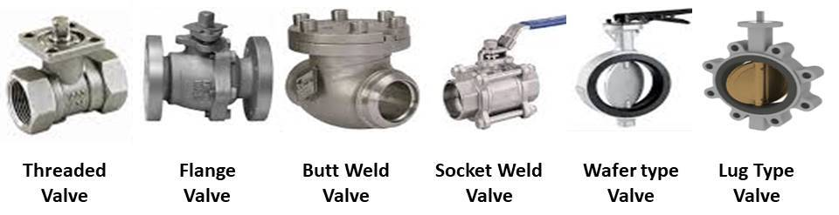
Valves: All salves shall be listed for the intended use. Selector valves shall be of the quick.opening type. Selector sakes shall allow free passage of the dry chem. icaL
Pipe and Fittings:
Pipe and fittings shall be of noncombustible material having physical and chemical characteristics such that their integrity under stress can be predicted with reliability. The pipe. fittings, and connection joints shall withstand the maximum expected pressure in the piping system.
Pipe and fittings shall be galvanized steel, stainless steel. copper. or brass. Special corrosion resistant materials or coatings shall be required in severely corrosive atmospheres. Black steel pipe and fittings shall be permitted in non corrosive atmospheres

Slide 14
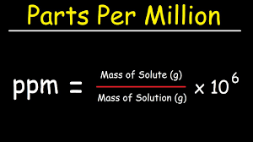
Expellant Gas.
Carbon dioxide used in expellant gas cartridges shall meet the following specifications:
The vapor phase shall not be less than 99.5 percent carbon dioxide.
The water content of the liquid phase shall not be more than 0.01 percent by weight I-30°F (-34.4°C) dew point).
The oil content shall not be more than 10 ppm by weight_
Nitrogen used as an expellant gas shall be standard industrial grade with a dew point of-60°F (-52.2°C) or lower.
Electrical Wiring and Equipment Electrical wiring and equipment shall he installed in accordance with NFPA 70.

Slide 15
Chapter 5: System Requirements

Slide 16
Use and Limitations.
Use:
The types of hazards and equipment that shall be protected using dry chemical extinguishing systems shall include the following:
(I) flammable or combustible liquids
CAUTION: Extinguishment of flammable liquid fires. especially Class 1 liquids (set NFPA 30). an result in a reflash unless all sources of ignition have been removed.
(2) Flammable or combustible gases
CAUTION: Flammable gases present a potential explossion hazard if the flow of gas is not stopped before or during extinguishment.
(3) Combustible solids. including plastics. that melt when involved in fire
(4) Electrical hazards such as oil-filled transformers or circuit breakers
(5) Textile operations subject to flash surface fires
(6) Ordinary combustibles such as wood, paper. and cloth
(7) Restaurant and commercial hoods. ducts• and associated cooking appliance hazards such as deep-fat fryers

Slide 17
Limitations
Dry chemical extinguishing systems shall not be considered satisfactory protection for the following
(I) Chemicals containing their own oxygen supply. such as cellulose nitrate
(2) Combustible metals such as sodium, potassium. magnesium, titanium, and zirconium
(3) Deepstated or burrowing fires in ordinary combustibles where the dry chemical cannot reach the point of combustion
Multipurpose dry chemical shall not be used on machinery such as carding equipment in textile operations and delicate electrical equipment.

Slide 18
Before dry chemical extinguishing equipment is considered for use in protecting electronic equipment or delicate electrical relays, the effect of residual deposits of dry chemical on the performance on electronic equipment shall be evaluated.
Dry chemical extinguishing system equipment shall be used within its listed temperature limitations
The agent storage container shall be marked to indicate the listed minimum and maximum temperature limitations of the fire suppression system equipment.
The minimum temperature limitation shall be at most 32°F (0 C).
The maximum temperature limitation shall be at least 120'F (48.9 degree c).

Slide 19
Dry Chemical Requirements and Distribution
General
The following factors shall be considered in determining the amount of dry chemical required:
Minimum quantity of dry chemical
Minimum flow rate of dry chemical
Nozzle placement limitations. including spacing. distribution. and obstructions
High ventilation rates. if applicable
Prevailing wind conditions. if applicable
The amount of dry chemical required for pre-engineered systems and hand hose line systems shall be determined in accordance with Chapter 7.

Slide 20
Special Considerations.
Where systems protect hazards that are normally heated, the power or fuel supply to heaters shall be shut off automatically upon actuation of the extinguishing systems.
CAUTION: Hazards to Personel.
The discharge of large amounts of dry chemical can create hazards to personnel such as reduced visibility and temporary breathing difficulty:
Safety procedures shall provide a means for prompt rescue of any trapped personnel.
Safety items to be considered shall include. but not be limited to. the following:
Personnel training
Warning signs
Predischarge alarms
Discharge alarms
Respiratory protection
Emergency eye wash stations

Slide 21
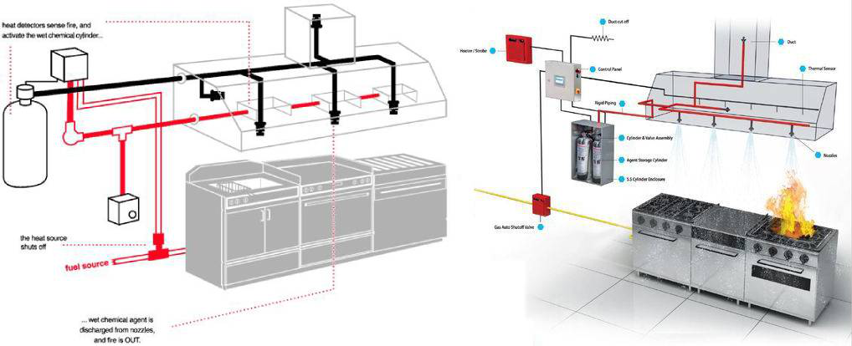
Dry Chemical and Expellant Gas Supply.
The dry chemical container and expellant gas assemblies utilizing nitrogen shall be located where the ambient temperature is normally —40°F to 120°F (-40°C to 489°C).
Assemblies tinkling carbon dioxide shall be looted where the ambient temperature is normally 32°F to 120°F (0°C to 48.9°C).

Slide 22
5.9 Piping.
Pipe Size and Nozzle Determination.
For engineered systems. pipe sizes and nozzles shall be selected. on the basis of calculations. to dater the required dry chemical flow rate at each nozzle.
For pre-engineered systems, pipe sizes and nozzles shall be selected in accordance with the manufacturer's listed installation and maintenance manual.
Equations. graphs. or computer software shall be used to determine the pressure drop in the pipeline in engineered systems.

Slide 23
Chapter 6: Total Flooding Systems

Slide 24
General.
A total flooding system shall be used only where there is a permanent enclosure surrounding the hazard that adequately enables the required concentration to be built up.
The total area of enclosable openings shall not exceed 15 percent of the total area of the sides, top. and bottom of the enclosure.
Where the total area of enclosable openings exceeds 15 percent of the total enclosure surface area, a local application system shall be used to protect the entire hazard.
Pre-engineered total flooding systems shall be permitted to protect permanent enclosures having enclosable openings greater than 15 percent only when listed for such use.
Deep-seated fires invoking solids subject to smoldering shall be protected by multipurpose dry chemical systems where the dry chemical can reach all surfaces involved in combustion. Bicarbonate-based dry chemicals shall not be used for protection against this type of fires.

Slide 25
Hazard Specifications.
The total area of unclosable openings for which no compensation is provided shall not exceed 1 percent of the total area of the sides. top. and bottom of the enclosure.
Unclosable openings having an area in excess of 1 percent of the total enclosure area and not exceeding 5 percent shall be compensated for by the provision of additional dry chemical in accordance with 6.2.2.6.
Unclosable openings having an area in excess of 5 percent of the total enclosure area and not exceeding 15 percent shall be screened by local application of additional dry chemical

Slide 26
Leakage and Ventilation:
The leakage of dry chemical from the protected space shall be minimized because the effectiveness of the flooding system depends on obtaining an extinguishing concentration of dry chemical.
Where possible, openings such as doorways and windows shall be arranged to close before or simultaneously with the start of the dry chemical discharge.
Where forced-air ventilating systems are involved, they shall be either shut down or closed before or simultaneously with the start of the dry chemical discharge.
The quantity of dry chemical and the flow rate shall be sufficient to create a fire-extinguishing concentration in all parts of the enclosure.

Slide 27
Chapter 8
Hand Hose Line Systems
Where hand hose lines are used on a handed that is also protected In a fixed system, separate dry chemical supplies shall be provided.
If a single dry chemical supply is used for both a hand hose line system and a fixed nozzle system. the hazards protected by the two systems shall be separated so that the hand hose lines cannot be simultaneously used on the hazard protected by the fixed nozzle system.
Hand hose line systems shall be permitted to supplement fixed nozzle fire protection systems or to supplement portable fire extinguishers for the protection of specific hazards for which dry chemical is a suitable extinguishing agent.

Slide 28
Dry Chemical Requirements.
Rate and Duration of Discharge:
A hand hose line shall have a sufficient quantity of dry chemical to permit its effective use for a minimum of 30 seconds.
The minimum flow rate also shall be sufficient to prevent surging and interrupted discharge.
The value for minimum flow rate shall be confirmed by a testing laboratory.
Simultaneous Use of Hose Lines: Where simultaneous use of two or more hose lines is possible, a sufficient quantity of dry chemical shall be available to supply the maximum number of nozzles that are likely to be used at any one time for at least 90 seconds and at the appropriate flow rates.

Slide 29
Chapter 9
Pre-Engineered Systems

Slide 30
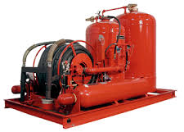
What is Pre-Engineered Systems?
Those systems having predetermined flow rates, nozzle pressures, and quantities of extinguishing agent. and having specific pipe size, maximum and minimum pipe lengths, flexible-hose specifications, number or. fittings, and number and types of nozzles.

Slide 31
Used components shall not be permitted to be installed in new systems.
Types of Systems. Pre-engineered dry chemical systems shall be of the following types:
Local application
Total flooding
Hand hose line
Combination of local application and total flooding
Commercial Kitchen Hood. Duct, and Cooking Appliance Systems.
Dry chemical fire-extinguishing systems for commercial kitchen hood. duct, and cooking appliances shall comply with UL 300, Fire testing of For Extinguishing systems for Protection of Conttnerrial Cooking Equigtnent or an equivalent listing standard.

Slide 32
At least one fusible link or heat detector shall be installed within each exhaust duct opening in accordance with the manufacturer's listing.
A fusible link or heat detector shall be provided above each protected cooking appliance and in accordance with the extinguishing system manufacturer's listing. Fusible links or heat detectors located at or within 12 in. (305 mm) into the exhaust duct opening and above the protected appliance shall be permitted to meet this requirements.

Slide 33
Shutoff Devices
Upon actuation of any cooking equipment fire-extinguishing system, all sources of fuel and electric power that produce heat to all equipment protected by the system shall be shut down.
Steam supplied from an external source shall not require shutdown.
Exhaust fans and dampers shall not be required to be shut down upon system actuation.
Any gas appliance not requiring protection but located under the same ventilating equipment shall be automatically shut off upon actuation of any extinguishing system.
Shutoff devices shall require manual resetting prior to fuel or power being restored.
Where an electrical gas valve is used for shutting off gas to appliances, a manually reset relay shall be used to restore electrical power to the gas valve.

Slide 34
Review and Certification.
If required. complete drawings of the system installation shall be submitted to the authority having jurisdiction for review and approval.
System drawings shall include the following:
Hood(s)
Exhaust duct(s)
Appliances
Interface of the fire-extinguishing system detectors
Piping
Nozzles
Fuel shutoff devices
Agent storage container(s)
Manual actuation & sleep

Slide 35
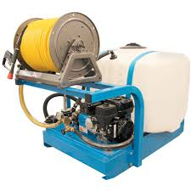
Hand Hose line Systems.
Dry chemical hand hose line systems shall be provided with skid-mounted hose reels, remote hose reels, or combinations thereof.
The length and size of piping and hose and the type of nozzles shall be within the limitations stated in the manufacturer's design. installation, and maintenance manual.
Differences in elevation between the dry chemical storage tank and hose reel shall be within the limitations of the manufacturer's design. installation. and maintenance manual.
If multiple cylinders are used to pressurize the dry chemical agent containers, each cylinder shall be provided with a pressure gauge and a manual means of operation.

Slide 36
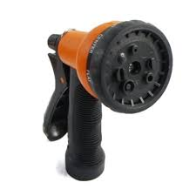
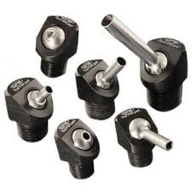
Slave cylinders without manual actuators shall be permitted if at least two master cylinders with manual actuators are provided.
Only one manual actuator shall be required to be provided for self-contained skid-mounted systems.
Each turret and hose reel shall be provided with a shutoff nozzle or flow control valve.
An integral method shall be provided to blow out all system piping and hose reels after any me.
Turret nozzles shall he provided with caps or other suitable devices to prevent moisture or foreign materials from entering the turret or piping.

Slide 37
Chapter 10
Plan and Acceptance Tets

Slide 38
Specifications.
Specifications for dry chemical extinguishing systems shall be drawn up with are under the supervision of a trained person and with the advice of the authority having jurisdiction.
Plans shall be required for all engineered systems.
The specification shall indicate that only equipment that is specifically listed and compatible for use with the extinguishing system shall be used.
The specification shall indicate special auxiliary devices acceptable to the system manufacturer and the authority having jurisdiction.

Slide 39
The specifications shall include system acceptance tests.
The specifications shall indicate the hazard to be protected and shall include such information as physical dimensions. combustibles, air-handling equipment heat sources. and so on.
Plans: Where plans are required, they shall be prepared by qualified persons trained in the design and application of these systems.
The plans shall be drawn to an indicated scale or be suitably dimensioned and shall be reproducible.
The plans shall contain sufficient detail to enable the authority having jurisdiction to evaluate the hazard or hazards and to evaluate the effectiveness of the system.

Slide 40
The details on the system shall include sufficient information and calculations on the following:
The amount of dry chemical
The size. length. and arrangement of connected piping or of piping and hose
The description and location of nozzles so that the adequacy of the system can be determined
Flow rates of nozzles used shall be provided for engineered systems.
Approval of Plans: Where plans are required. they shall be submitted to the authority having jurisdiction for approval before work starts.

Slide 41
Chapter 11 Inspection, Maintenance, and Recharging

Slide 42
Protective caps also shall be used on empty pressure containers to protect threads.
Protective caps shall be prodded by the manufacturer of the equipment
Storage
Storage of charging supplies of dry chemical shall be in a constantly dry area, and the dry chemical shall be contained in metal drums or other containers that will prevent the entrance of moisture even in small quantities.
Prior to the dry chemical chamber being charged. the dry chemical shall be checked carefully to determine that it is in a flowing condition.
A service technician who performs maintenance on an extinguishing system shall be trained and shall have passed a written or online test that is acceptable to the authority having jurisdiction.
The service technician shall possess a certification document confirming the requirements in 11.1.3 issued by the manufacturer or testing organization that is acceptable to the authority having jurisdiction.

Slide 43
Recharge Agents.
Dry chemical provided for the system shall be listed for the system.
Expellant gas for stored pressure cylinders shall be standard industrial-grade nitrogen with a dew point of -60°F (-51) or lower (C.GA nitrogen specification G10.1).
The dry chemical provided by the equipment manufacturer and the type of expellant gas specified by the equipment manufacturer shall be required to be used.
Where carbon dioxide or nitrogen is used as the expellant gas. it shall be of good commercial grade and free of water and other contaminants that might cause container corrosion.

Slide 44
Owners Inspection.
As a minimum, inspection shall include verification of the following:
The extinguishing system is in its proper location.
The manual actuators are unobstructed.
The tamper indicators and seals are intact.
The maintenance tag or certificate is in place.
The system shows no physical damage or condition that might prevent operation.
The pressure gauge(s). if provided. is inspected physically or electrically to ensure it is in the operable range.
The nozzle blowoff caps. where provided. are intact and undamaged.
Neither the protected equipment nor the hazard has been replaced. modified. or relocated.

Slide 45
Maintenance.
As a minimum, such maintenance shall include the following:
(I) A check to see that the hazard has not changed
(2) An examination of all detectors. expellant gas container(s), agent container(s). releasing devices. piping. hose assemblies. nozzles, signals. and all auxiliary equipment
(3)* Verification that the agent distribution piping is not obstructed
(4) Examination of the dry chemical (If there is evidence of caking. the dry chemical shall be discarded and the system shall be recharged in accordance with the manufacturer's instructions.)

Slide 46


Slide 47


