Slide 1

NORTHERN UNIVERSITY
B A N G L A D E S H
Team Alpha
Project Presentation on
Multi-Vendor E-Commerce Website Using Laravel & MySQL

Slide 2
Submitted by:
Sl. | Student’s Name | Students ID | Email | Phone
01 | Md. Eamin Hossain | 21180100742 (8A) | yeaminhossain2@gmail.com | +88 01750691974
02 | Md. Fazlur Rahaman | 21180100757 (8A) | fazlurrahaman.didar@gmail.com | +88 01727346514
03 | Md. Abdus Salam | 21180100740 (8A) | mdabdussalam9508@gmail.com | +88 01783299508
Submitted to:
Name Of The Teacher | Remarks
Sanjida Akter Senior Lecturer, Department of Computer Science & Engineering Faculty of Science and Engineering Northern University Bangladesh

Slide 3
Introduction:
The title of this project is “Multi-Vendor e-commerce Website Using Laravel & MySQL”. This project will handle the Electronic transactions of goods and services between companies and consumers. This Multi-vendor e-commerce website will assist to sell services directly to customers and can assist to earn profit by inviting different vendors to sell their services on website.
Description:
Multi-Vendor e-commerce Website is developed as a web-based application using PHP Laravel frame work for back-end design and MySQL for database storage at the back-end. It is based on Relational Database Management System (RDBMS) technology, and can be run on any network environment.

Slide 4
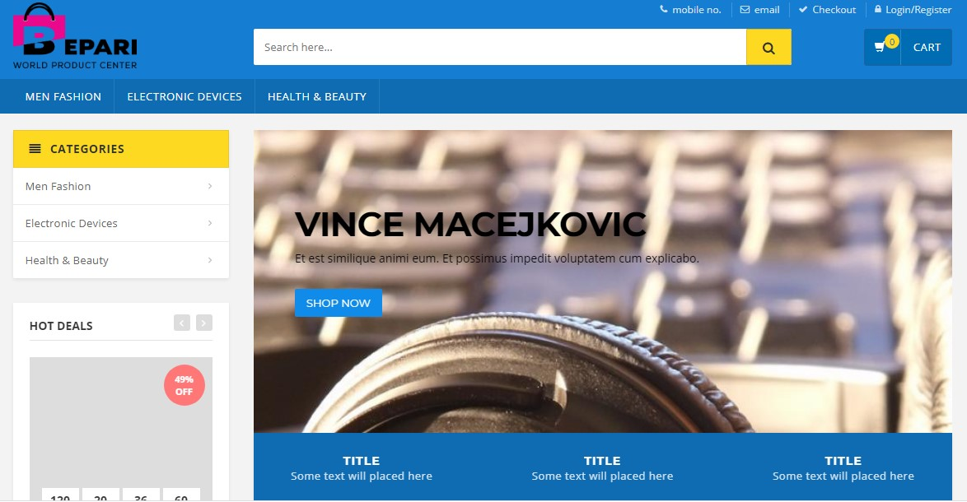
Implementation:

Slide 5
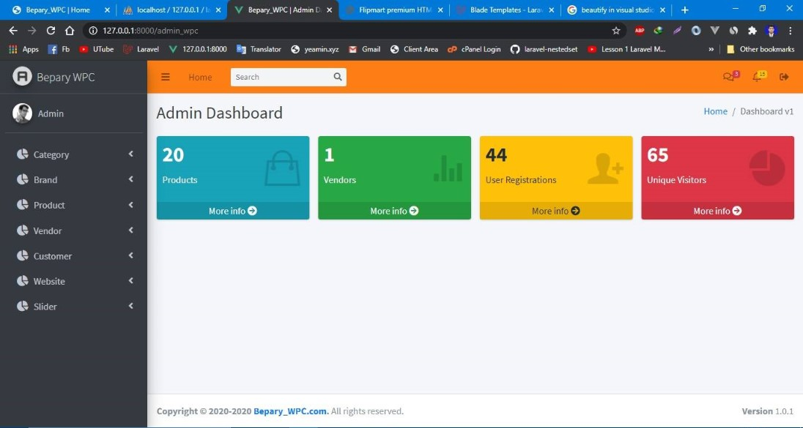

Slide 6
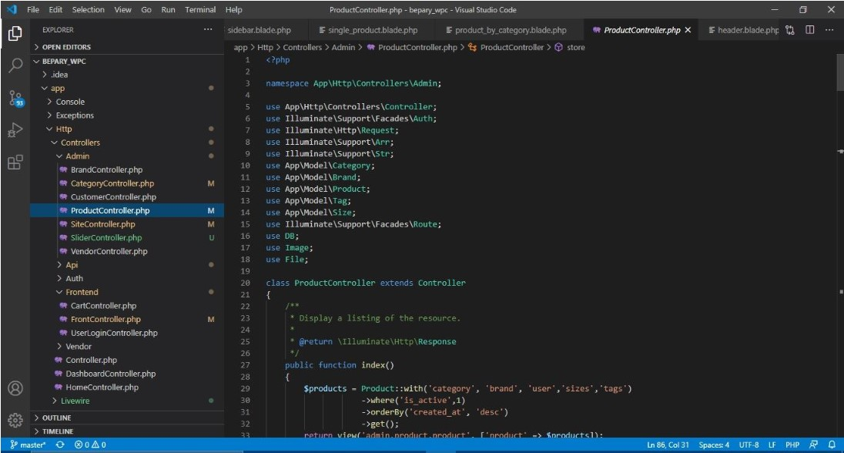

Slide 7
Features:
This project is based on the Relational Database Management System (RDBMS) technology; the main objective of this project is to get different vendors/Supplier’s and customers under one roof. In other words, we can say that our project has the following objectives:
Maintain information of vendors/Suppliers and customers.
Multiple payment options (Credit card, Bkash, Rocket etc.).
Reduce time consumption.
Promotion and discount code tools.
Quick and Correct Search Options.
All system managements are automated.
Centralized database management.
Easy operations for operator of the system.

Slide 8
Software Requirement:
Operating System : Windows 7,8 10 & Server 2012, 2016
Database Server : MySQL
Back end : PHP
Tools/ Platform:
This project is developed using the tools, which are most suited for development of the Application Package. These tools are as follows:
Laravel (For back end)
MySQL (For Database Storage as Back end)
Xampp, Bracket

Slide 9
Conclusion:
The project titled “Multi-Vendor e-commerce Website Using Laravel & MySQL” can be adopted by any company to meet their current management demand with the features presented here. The system is very easy to use, economic, reliable, and flexible. Operators can easily add new features, modules, forms, and components as per requirement in future.

